Slide 1
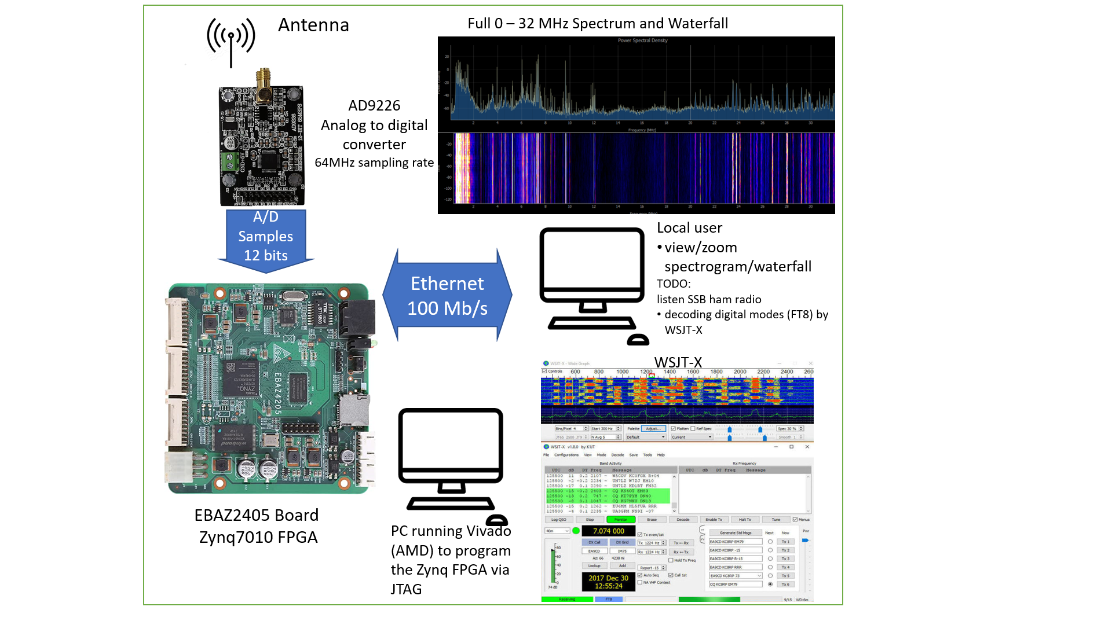

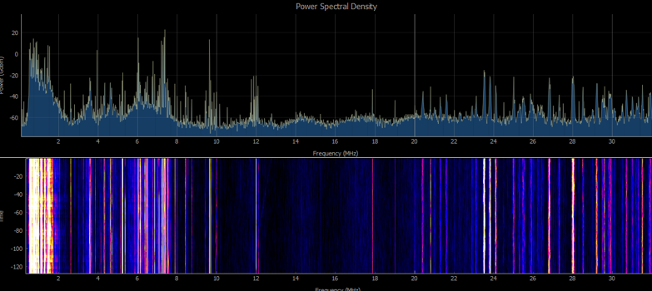
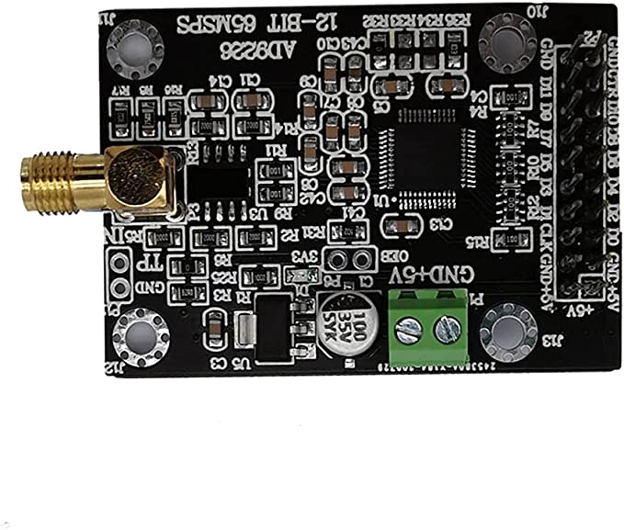

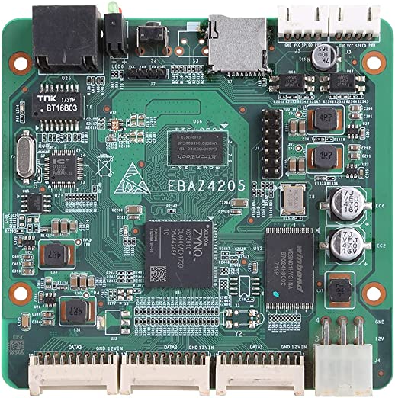
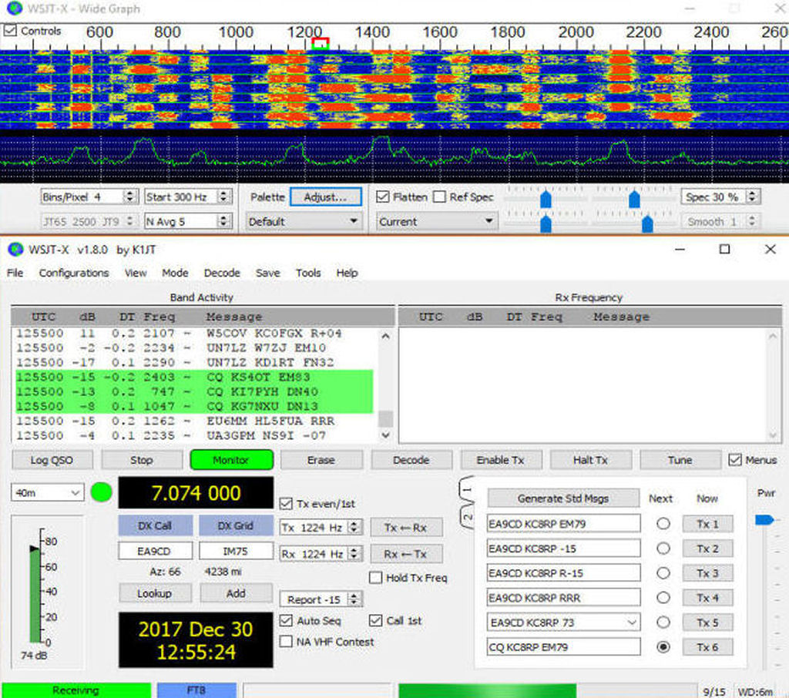
Antenna
Full 0 – 32 MHz Spectrum and Waterfall
AD9226
Analog to digital converter
64MHz sampling rate
A/D Samples
12 bits
Local user
view/zoom spectrogram/waterfall
TODO:
listen SSB ham radio
decoding digital modes (FT8) by WSJT-X
Ethernet 100 Mb/s
WSJT-X
EBAZ2405 Board
Zynq7010 FPGA

Slide 2

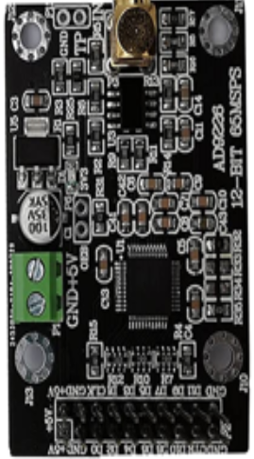
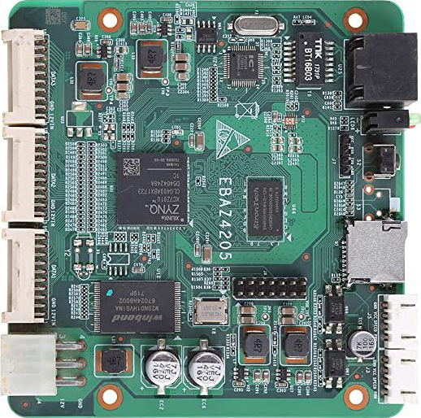

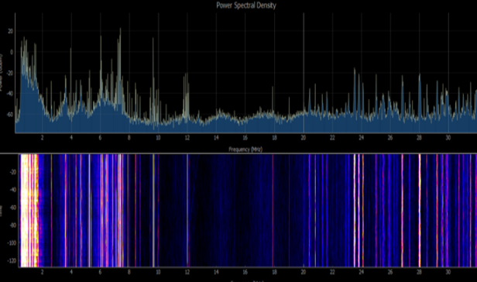
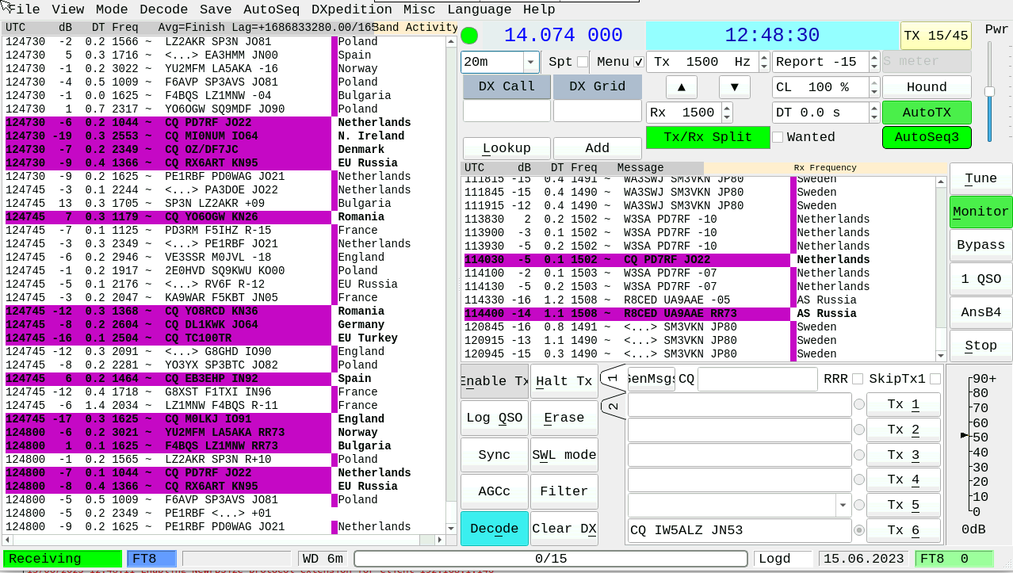

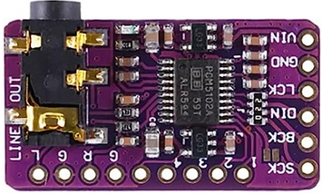

ADC 64 MHz
HDMI
Spectrum + FT8 decoder
I2S
Audio
PS2 Mouse

Slide 3
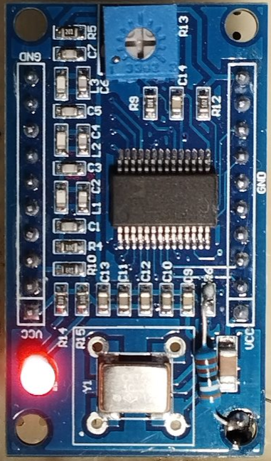
ADC 64 MHz
HDMI
Spectrum + FT8 decoder
I2S
Audio
PS2 Mouse
RF out

Slide 4
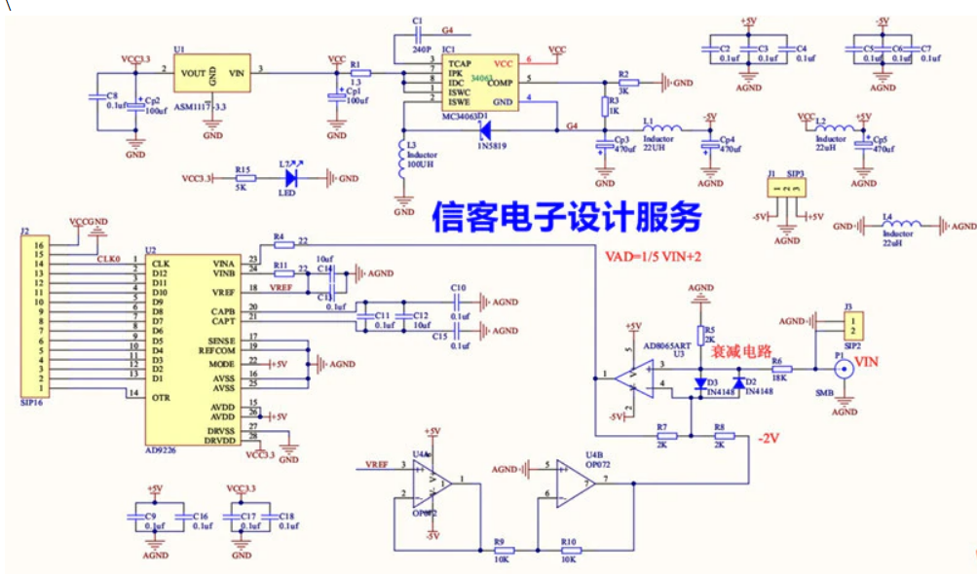

Slide 5
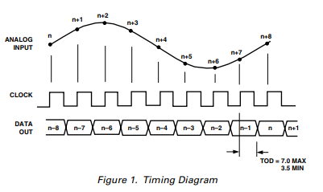
AD9226 output

Slide 6
Block diagram
DDC
Waterfall
0 – 1v
65MSps
256 KSps
A/D
DDC
Audio
DMA

Slide 7
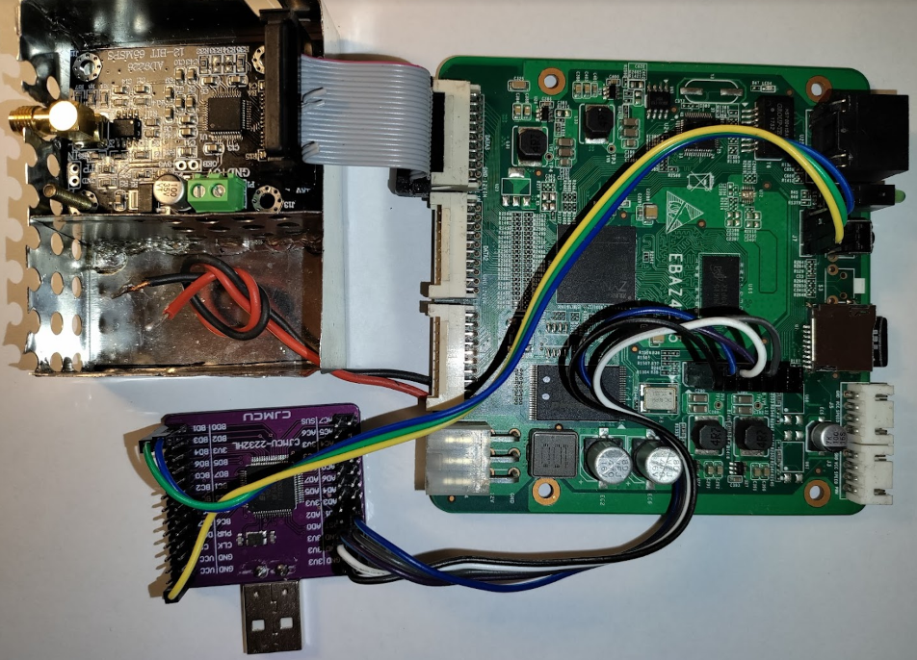
16 wires ADC <-> FPGA (PL)
EBAZ4205 board with Zynq-7000 (PS+PL)
Shielded ADC
Ethernet
UART
Shielded power supply filter (TODO)
JTAG
USB <-> JTAG
&
USB <-> UART

Slide 8
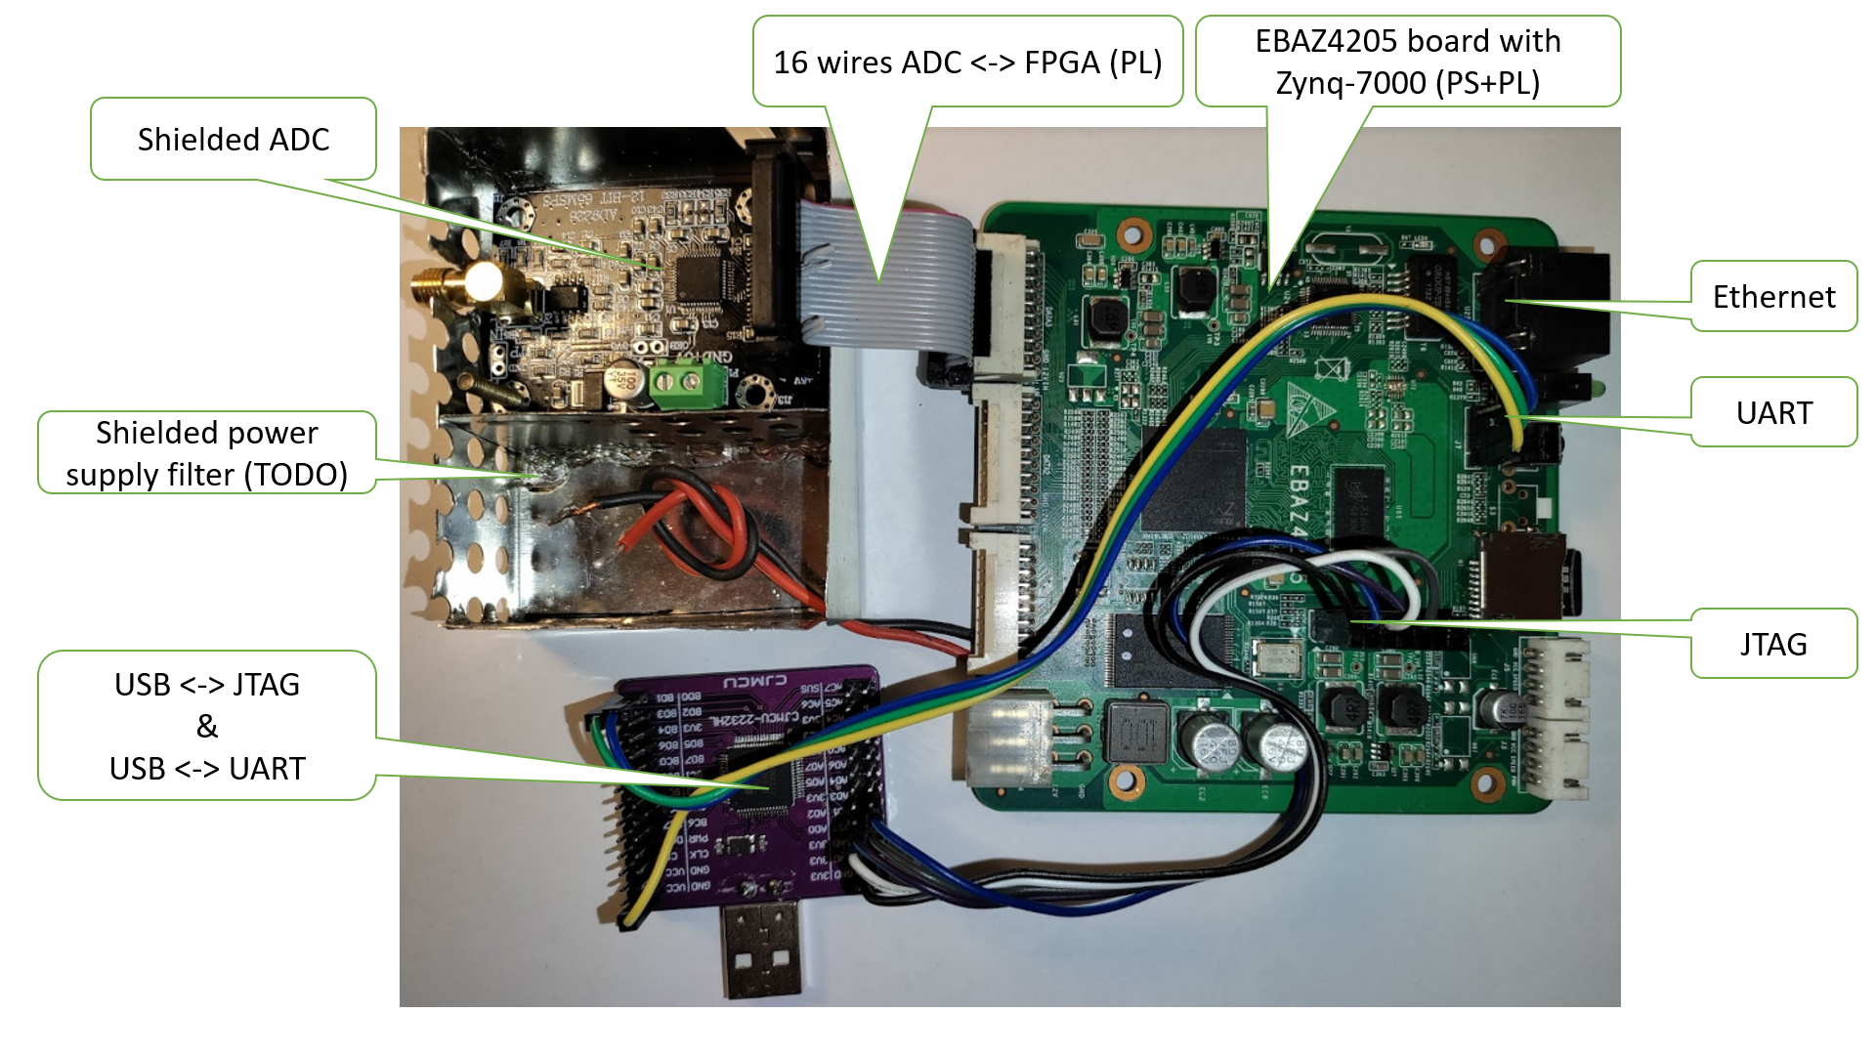

Slide 9
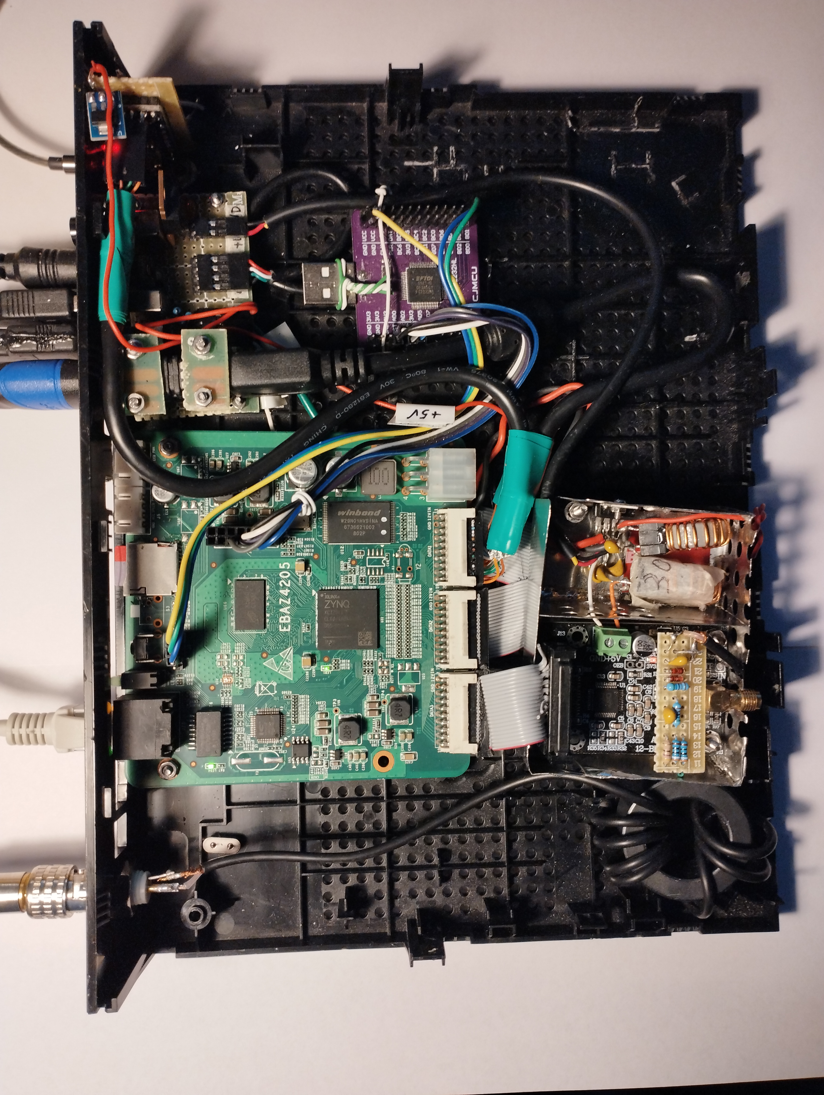
Audio out
(headphone)
I2S DAC
+5 to +3.3V
AS1117
I2S DAC
PCM5102
USB to TTY + JTAG
+12V input
I2S shielded cable
USB
(TTY + JTAG)
PS2
Mouse
HDMI (TMDS)
shielded cable
HDMI
HDMI + I2S
JTAG
+12V → +5V (7805)
and +5V filter
SD memory
32 GB
PS2 connector
TTY0
Zynq 7z010
+5V ADC input
Ethernet
12 bits ADC
+ Out of Range
RF input stage
Antenna
No 25MHz
crystal
RG 174
Common mode
EMI filter
12 bits 64MHz ADC
AD9226

Slide 10
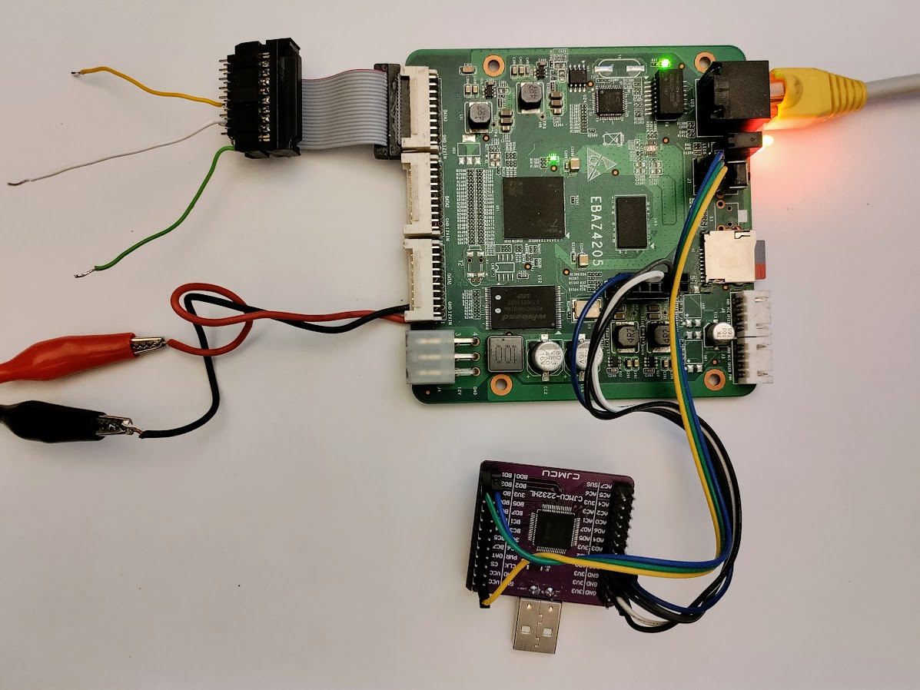
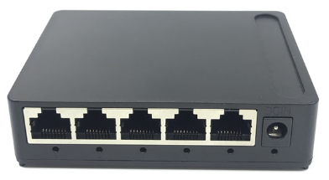
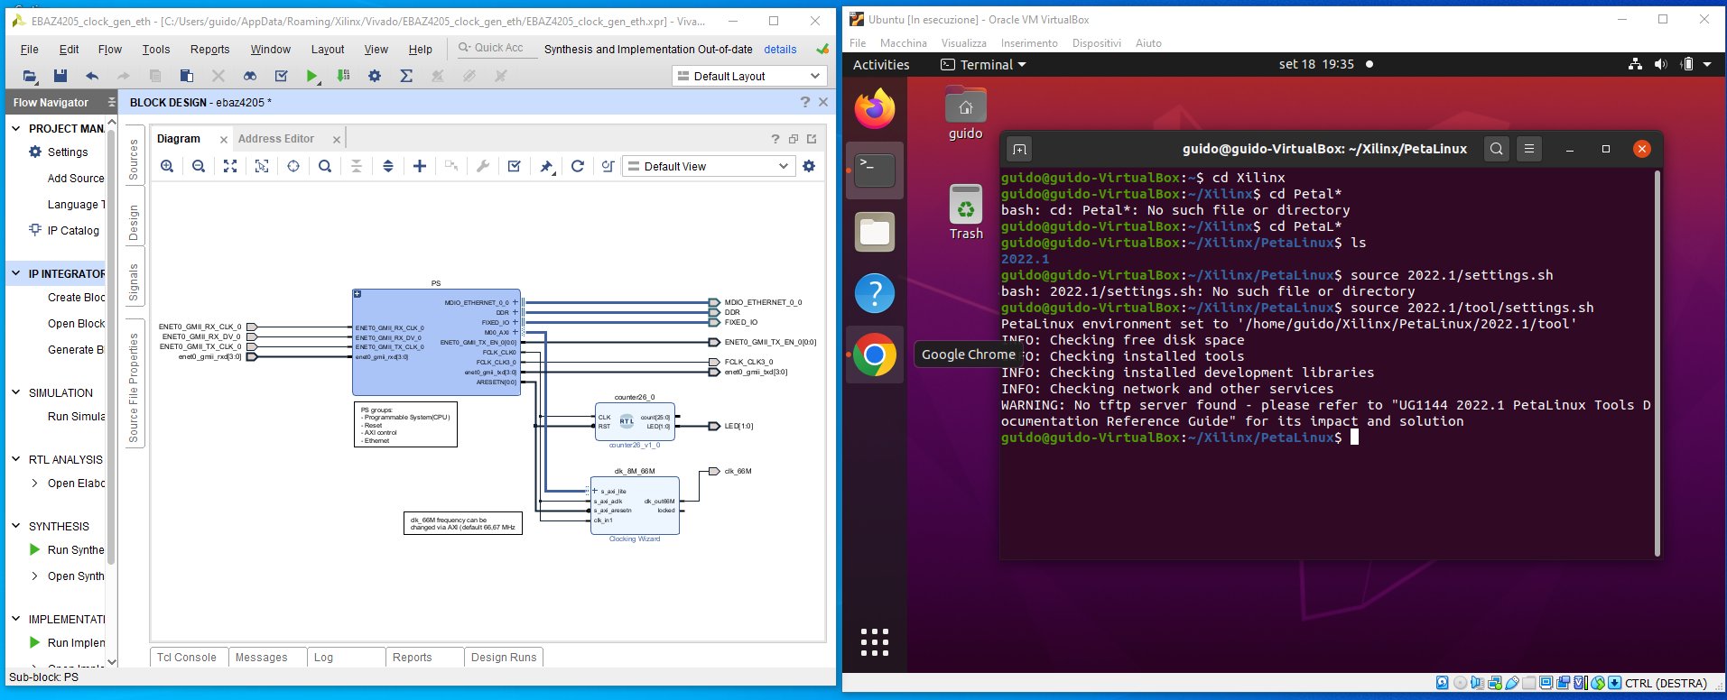
Test points
Ethernet
100 Mbits/sec
UART
100/1000 Mbits/sec
(option: Internet)
32GB SD
JTAG
12V 500mA
Ethernet
100 Mbits/sec
USB to
UART + JTAG
PC I7 10750
16 GB RAM – 2 TB SSD
USB
Windows 10 or 11
VIVADO 2021.2 for Windows
ORACLE VM VirtualBox 6.1.38
UBUNTU 20.04.1
PetaLinux Tools 2021.2

Slide 11
3 macro steps to design / test the Programmable Logic and the Linux / Standalone software
1) Set an initial basic block design on Vivado, prepare a Linux SD Card and first boot EBAZ4205
In PetaLinux:
Create a project
Configure it with the «Exported Hardware» (.xsa)
Build
Package (.wic)
In Vivado:
Create a basic block design
Generate bitstream (.bit)
Export hardware (.xsa)
In BalenaEtcher:
Flash the .wic package to a MicroSD (32GB)
On EBAZ4205:
Boot from MicroSD
Check if Ethernet is working
Start
2) Modify the block design on Vivado and test the results on EBAZ4205
In Vivado:
Modify the block design
Generate bitstream (.bit)
Convert .bit to .bin with bootgen
Send .bin to EBAZ4205 via JTAG
On EBAZ4205:
Check if the new block design is working as expected
Y
N
3) Modify/Debug the Standalone/Linux App on Vitis IDE and test the results on EBAZ4205
In Vitis:
Create/Modify an app
Debug it on EBAZ4205
Check if the App is working as expected
Y
N
End

Slide 12
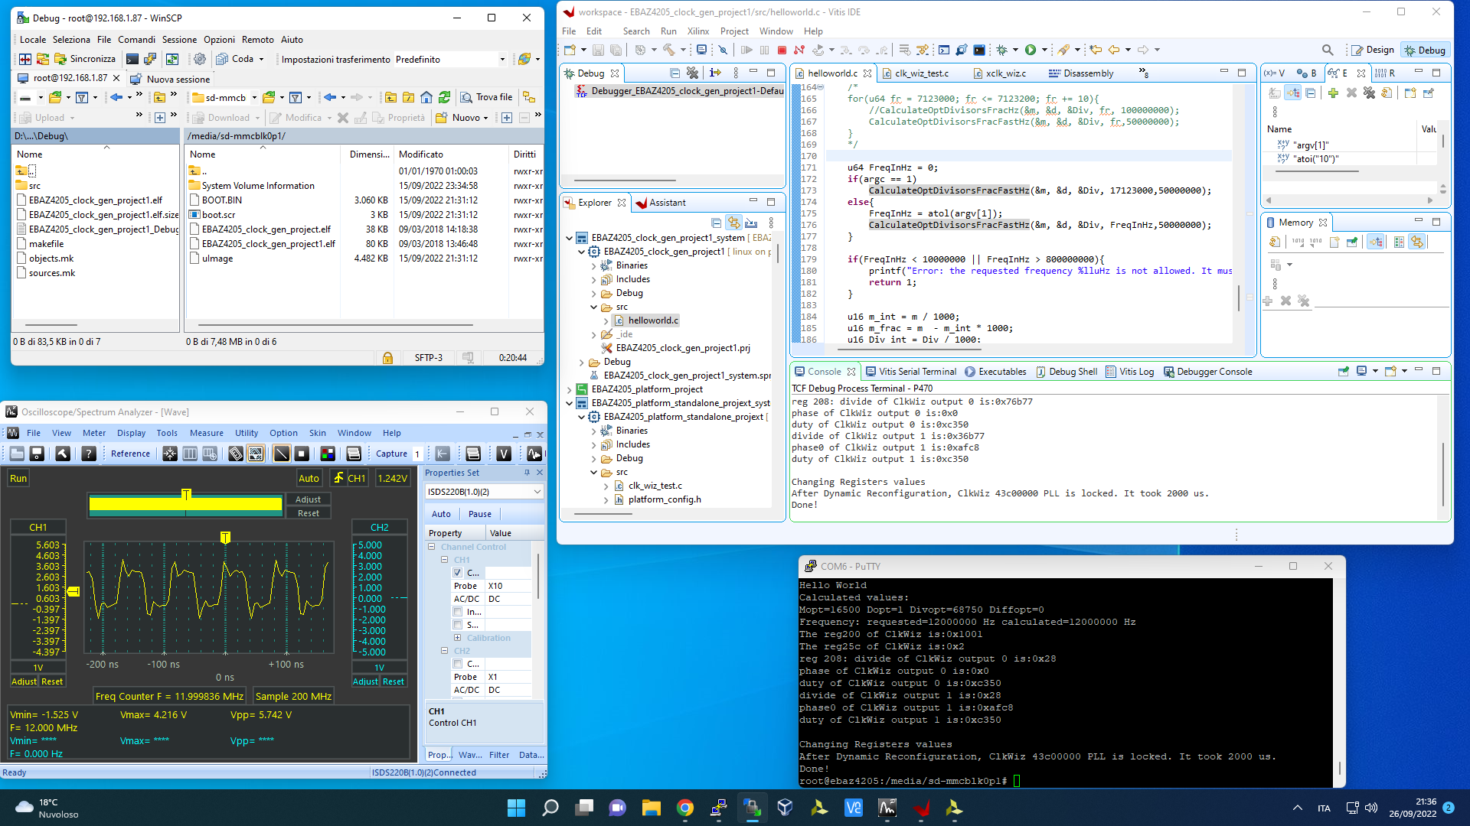
WinSCP:
Browse the Linux folders
Copy From/To Windows To/From Linux
Vitis IDE:
Debug / Run Linux Apps on EBAZ4205 via TCF (TCP port 1534)
Debug / Run Standalone Apps on EBAZ4205 via JTAG
Oscilloscope:
Examine hardware signals on testpoints
SSH (via IP) or TTY (via UART) EBAZ4205 Console:
Run Linux Apps
Configure Linux (Ethernet, Web Server, ALSA, …)

Slide 13

Zynq 7010 Programmable Logic
Zynq7010 PS (CPU)
Test Generator
0.1-30 MHz
AM modulated 1KHz
32 (13)
Data
Capture
16384 x 32 bits
13 bits (12 bits + OTR) – 64 MSps
Audio DDC
TCP Server
Ethernet
16 (12)
DEMOD
AM
LSB / USB
+
AGC
64 MSps
X
CIC - I
4-8192
FIR – I
2
16(16)
ADC
12 bits + OverRange
Sampler
Switch
16(16)
Memory mapped I/O
X
CIC - Q
4-8192
FIR – Q
2
16 (12)
2x16(16)
32(29)
Clocking Wizard
64MHz
DDS
100K – 32 MHz
I2S
I2S 32(29)
PCM 5102
(Digital to Analog)
Amplifier
Windows 10 PC
HPSDR
EXTIO
EBAZ4205 DLL
Ethernet

Slide 14

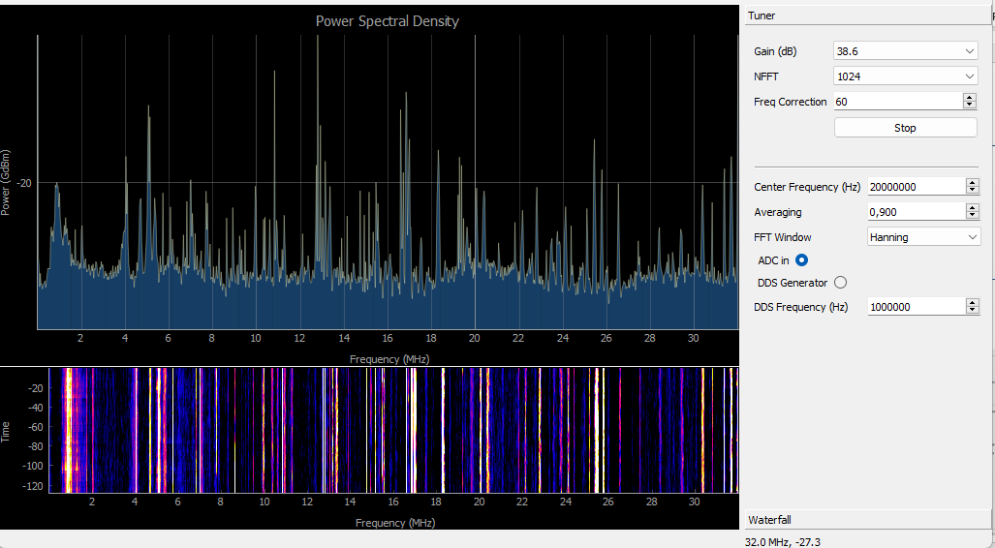
Zynq 7010 Programmable Logic
Zynq7010 PS (CPU)
Ethernet
Test Generator
0.1-30 MHz
AM modulated 1KHz
13 bits (12 bits + OTR) – 64 MSps
32 (13)
Data
Capture
16384 x 32 bits
Audio DDC
/dev/uio0
…
/dev/uio8
sdr-app
QT5 - C++
16 (12)
DEMOD
AM
LSB / USB
+
AGC
64 MSps
X
CIC - I
4-8192
FIR – I
2
16(16)
ADC
12 bits + OverRange
Sampler
Switch
16(16)
Memory mapped I/O
X
CIC - Q
4-8192
FIR – Q
2
Mouse driver
zgpio dev/input/event0
16 (12)
2x16(16)
32(29)
Clocking Wizard
64MHz
DDS
100K – 32 MHz
I2S
I2S
I2S
PS/2
mouse
HDMI TX
Simple Framebuffer
I2S 32(29)
Amplifier
PCM 5102
(Digital to Analog)

Slide 15
Zynq 7010 Programmable Logic
Zynq7010 PS (CPU)
Data
Capture RF
16384 x 16 bits
Test Generator
0.1-30 MHz
AM modulated 1KHz
13 bits (12 bits + OTR) – 64 MSps
Ethernet
16 (13)
Data
Capture FT
2 x 16384 x 16 bits
/dev/uio0
…
/dev/uio12
Sdr-app
+
WSJT-X
QT5 - C++
16 (12)
Spectrum DDC (Zoom FFT)
ADC
12 bits + OverRange
64 MSps
CIC - IQ
4-8192
FIR–IQ
2
I2S → DMA
Audio
xlnx-i2s-snd-card
Sampler
Switch
X
Memory mapped I/O
16 (12)
DDS
2K – 32 MHz
Mouse driver
zgpio dev/input/event0
Low pass
Filter
32 MHz
Clocking Wizard
64MHz
AM / LSB / USB DEMOD
Audio DDC
Simple Framebuffer
CIC-IQ
4-8192
FIR-IQ
2
32(32)
X
Ampl
X1-1024
I2S
RF switch
AD9851 IP
DDS
10K – 32 MHz
PS/2
mouse
HDMI TX
5
I2S 16(16)x2
RF linear power amplifier
AD9851 board
Amplifier
PCM 5102
(Digital to Analog)
Configurable from / readable from /
write to /
PS (CPU)

Slide 16
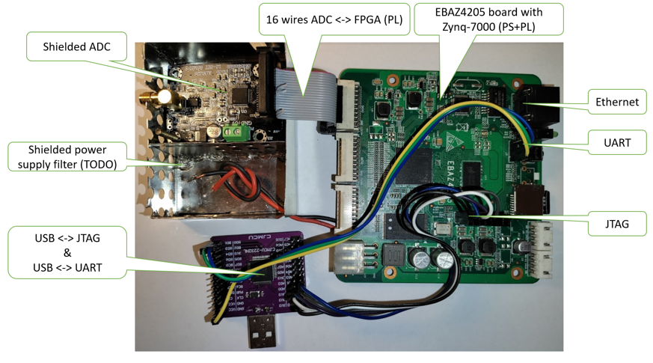
Zynq 7010
Programmable Logic
Zynq7010 PS (CPU)
13 bits
64 MSps
ADC
12 bits + OverRange
Sampler
13 bits
64 MSps
MUX
(switch)
Data
Capture
16384 x 32 bits
Windows 10 PC
TCP Server
SpectrumPy
Ethernet
Ethernet
Memory mapped I/O
RF test generator
100KHz-30MHz
64MHz
clock
Set Frequency

Slide 17
Zynq 7010
Programmable Logic
Zynq7010 PS (CPU)
13 bits
64 MSps
ADC
12 bits + OverRange
Sampler
13 bits
64 MSps
MUX
(switch)
Data
Capture
16384 x 32 bits
Windows 10 PC
TCP Server
SpectrumPy
Ethernet
Ethernet
Memory mapped I/O
RF test generator
100KHz-30MHz
64MHz
clock
Set Frequency

Slide 18
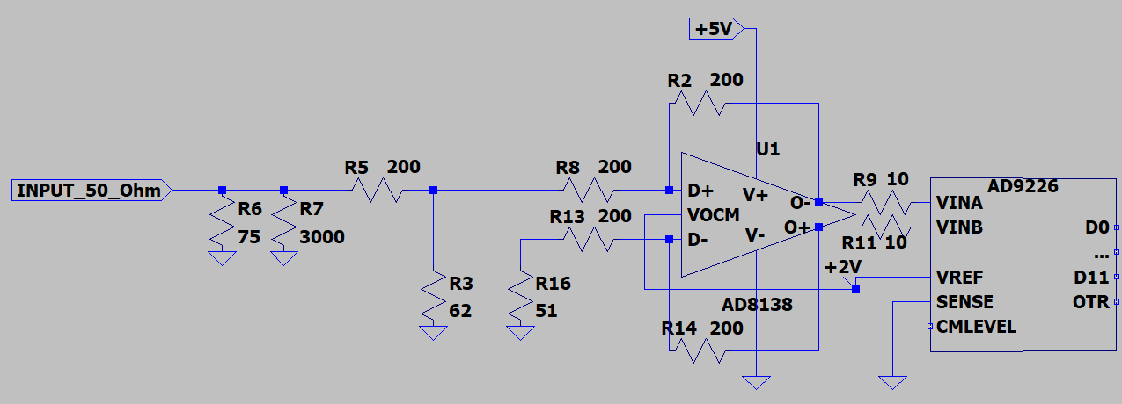
AD9226 board
Original schematic of the analog input
The overall amplification between VINA-VINB and INPUT_50_Ohm is approximatively:
200//62
-------------------- x (200/200 + 1) = 0,38 i.e. -8,4 dB
200 + 200//62
With SENSE = GND, the full scale between VINA and VINB is 2 Vpp
i.e.
VINA – VINB = +1V D11…D0=0xFFFFFF
VINA – VINB = 0V D11…D0=0x7FFFFF
VINA – VINB = -1V D11…D0=0x000000

Slide 19
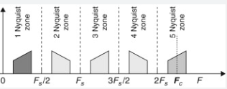
0 32 64 96 128 MHz

Slide 20
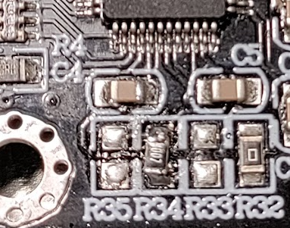
ADC9226 board
Change data outputs from Straight Binary to Two’s Complement
Two’s complement:
R35: not connected
R34: 10 KOhm
Straight Binary :
R35: 10 KOhm
R34: not connected

Slide 21
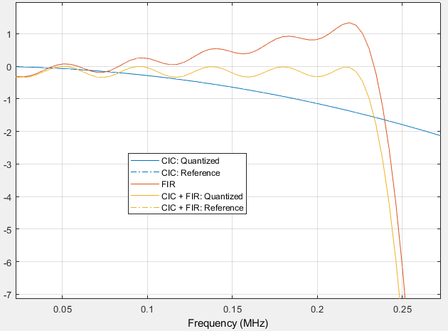
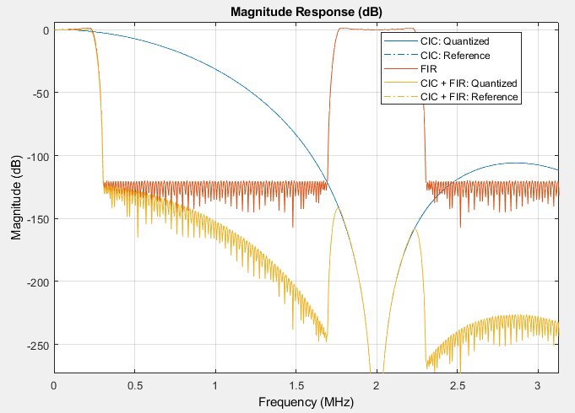
Filter Model
Bandwith can range from 1KHz to 2MHz changing decimation rate (R) only
Fs=64MHz Fs/R Fs/R .
CIC filter
R=4…8192 decimation
N=6 stages
FIR filter
L=110 coefficients
R | Bandwidth = Fs/R * 0.25 (Hz) | Fs/R (Hz) | Example
4 | 2M | 16M | Spectrum
8 | 1M | 8M | Spectrum
16 | 0.5M | 4M | Spectrum
32 | 0.25M | 2M | Spectrum
64 | 0.125M | 1M | Spectrum
128 | 62K | 0.5M | Spectrum
256 | 30K | 0.25M | AM / Spectrum
512 | 15K | 0.125M | AM
1024 | 8K | 62K | DSB / AM
2048 | 4K | 30K | FT8 / USB / LSB
4096 | 2K | 15K | FT8 / CW
8192 | 1K | 8K | WSPR / CW
CIC compensation
CIC compensation by FIR is indipendent from R (for R>=4)
High (>120dB) stopband attenuation

Slide 22
AM SSB Demodulator and AGC
AM Demodulator
LOW PASS
Level Meter
X
32(30)
32(31)
SQRT
AM
16(16)
MUX
+
HIGH PASS
X
16(15)
I
AGC
Automatic Gain Control
USB
Audio
to I2S
16(15)
32(31)
16(16)
Q
Weaver SSB Demodulator
>> 16
16(16)
X
+
32(32)
16(16)
X
LSB
-
32(32)
>> 16
16(16)
16(16)
16(16)
Local Oscillator (BFO) 10KHz
SIN
COS
xx(yy) is a xx bits two’s complement number with maximum value representable with yy bits e.g.
32 (28) is a 32 bits binary number, with
-(2^27) <= value <= (2^27) -1

Slide 23
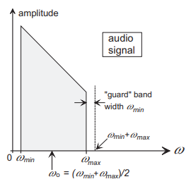
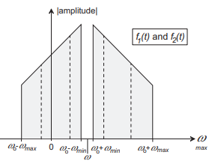

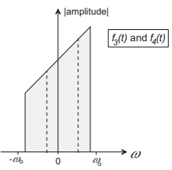



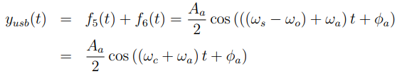

X
Low pass
X
+
X
Low pass
X

Slide 24
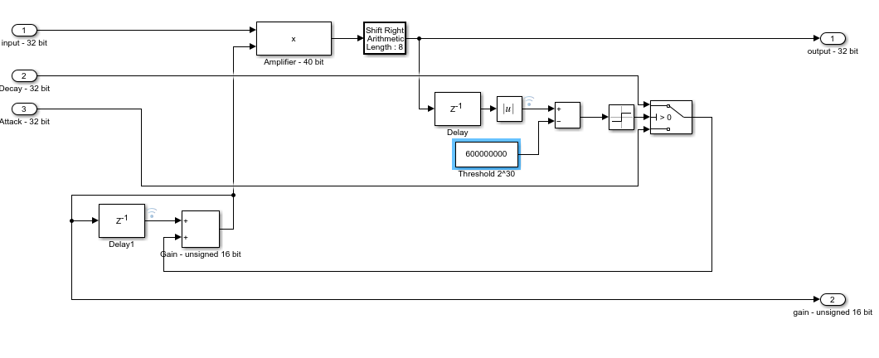
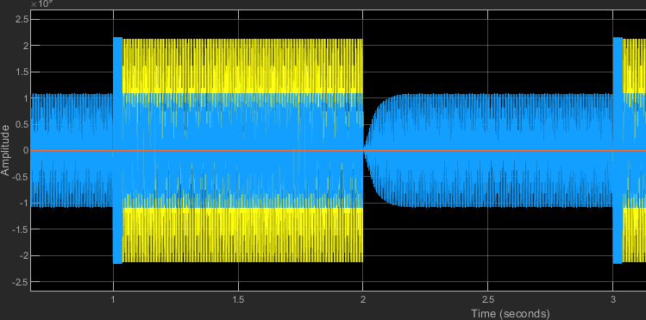
Automatic Gain Control
1) The input signal is amplified with a gain between 1 and 65535 (unsigned 16 bit)
2) then it is attenuated by 256 (2^8) so that the input signal can be attenuated / amplified
2^-8 2^8
3) Every 1/48000 seconds (sampling rate), Gain is:
increased by Attack - e.g. 8 if output is lower than 2^30
decreased by Decay (e.g. -16) ifoutput is higher than 2^30
To test the AGC, an input signal (in yellow) of amplitude 2^32 is alternated with the same signal of amplitude 2^32/200 (-46dB) every 2 seconds
Before the attenuation could take place in Decay time, the output signal is clipped (distorted) by the two’s complement 32 bit overflow
(+ - 2.147.483.648)
Input = 2^30*sin(2*pi*3000) + 2^30*sin(2*pi*400) i.e.
-2^31 <= input <= 2^31 -1
The output is in blue
The decay time
For 50 msecs set Decay = -16
The attack time
For 100 msecs set Attack = 8

Slide 25
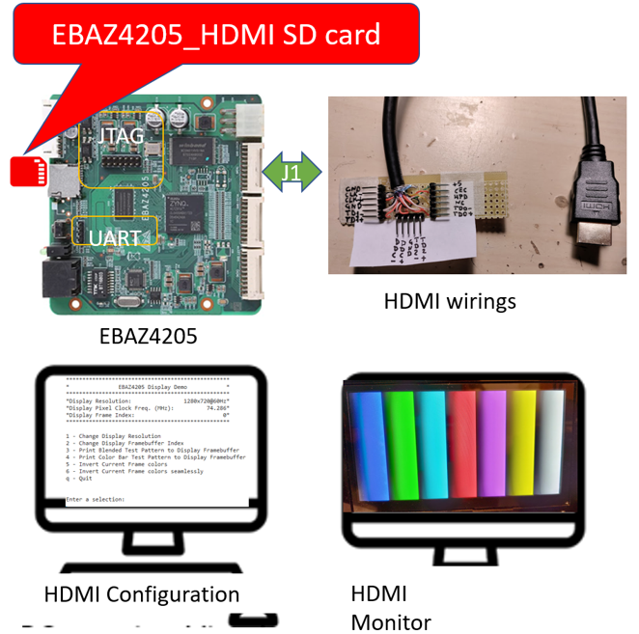
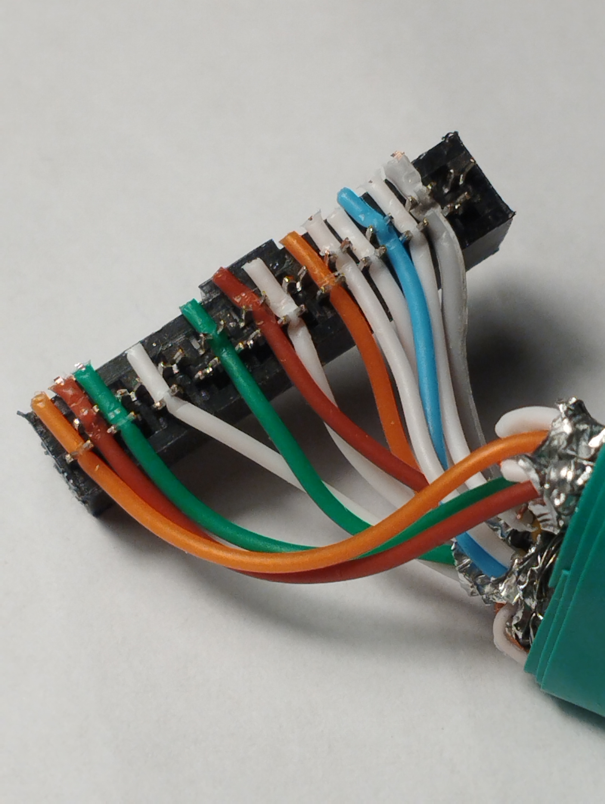
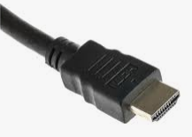

Slide 26
myjtdx architecture
Local
network
MainWindow
Record 15 seconds audio in a wav file (e.g. 230630_172215.wav)
Copy the wav file to the remote PC using:
scp -i /home/ebaz/.ssh/id_rsa/230630_172215.wav guido@192.168.1.83:/users/guido/JTDX/
Run the remote jt9.exe using:
ssh -i /home/ebaz/.ssh/id_rsa guido@192.168.1.83 '/wsjt/WSJTX/bin/jt9 -8 -d 3 /users/guido/JTDX/230630_172215.wav'
Read the stdout of the command to get all the FT8 decoded messages and send them to the DecodedTextBrowser widget in the mainwindow
AudioDevice
Remote Windows 11 PC with wsjt-x in installed: we use only jt9.exe

Slide 27
FT8 Transmitter
1) Follow the JTDX way: external DAC
Zynq-7000
Hardware
DAC (Digital to Analog Converter)
hardware Power Amplifier
PS running MYJTDX
PL Weaver modulator
2) My way: use an external DDS
Zynq 7000
Hardware AD9851 board
PL
8 bits PWM
PS running MYJTDX
PL
40 bits serializer
DDS+DAC
Power Amplifier

